Slide 1

GoldVista Jewellers Retail Analytics
Business Intelligence & Data Analytics Project
Presented by: Ragina V
POSTGRESQL
EXCEL
POWER BI
DAX
GITHUB

Slide 2
Agenda
This presentation walks through the end-to-end analytics project — from understanding the business problem to delivering actionable insights and recommendations.
01
02
Business Overview
Problem Statement
About GoldVista Jewellers
Key business challenges
03
04
Project Objectives
Data Architecture
What we set out to achieve
Technology stack & pipeline
05
06
Data Cleaning & Transformation
Data Model
Preparing raw data for analysis
Star Schema design
07
08
SQL Business Analysis
Power BI Dashboards
Eight business challenges solved
Interactive visual reporting
09
10
Key Insights & Recommendations
Conclusion
Findings and next steps
Project summary

Slide 3


Business Overview
About GoldVista Jewellers
GoldVista Jewellers is a multi-branch jewellery retail business offering Gold, Diamond and Silver products. The business handles sales, returns, and old gold buy-back transactions, serving thousands of customers across multiple branches.
Product Range
Transaction Types
Gold, Diamond, Silver & Platinum jewellery across all branches
Sales, returns, and old gold buy-back activities managed centrally
Customer Base
Thousands of customers served across multiple retail branches
Purpose: Convert raw transactional data into actionable business insights.

Slide 4

Problem Statement
Business Challenges
GoldVista's operations were constrained by manual processes and a lack of centralized visibility, making it difficult to monitor performance across branches, products, customers, and staff.
Reporting & Visibility
Manual reporting processes with no centralized dashboard. Poor visibility into returns and buy-back activities across branches.
Performance Tracking
Difficulty comparing branch performance and monitoring individual salesperson effectiveness.
Analytics Gaps
Limited customer analytics and no product performance tracking to guide business decisions.

Slide 5
Project Objectives
The project aimed to build a comprehensive BI solution addressing every layer of GoldVista's operations — from executive KPIs to frontline salesperson performance.
Interactive BI Solution
Branch & Customer Analysis
Build an interactive BI solution to track executive KPIs and enable data-driven decision-making across the business.
Analyze branch performance and understand customer behavior to identify trends and opportunities.
Product & Returns Monitoring
Payment & Salesperson Insights
Evaluate product performance and monitor returns and buy-back trends to optimize inventory and operations.
Analyze payment method preferences and measure salesperson effectiveness across all branches.

Slide 6
Technology Stack
Each layer of the project leverages a purpose-built tool, forming a modern, end-to-end analytics pipeline from raw
data to interactive dashboards.
PostgreSQL
SQL
Database layer for storing and querying transactional data
Data cleaning and transformation using SQL views
SQL + DAX
Power BI
Business analysis and calculated measures
Interactive visualization and dashboard layer
GitHub
Excel
Version control for all project files and scripts
Documentation and supplementary data analysis

Slide 7
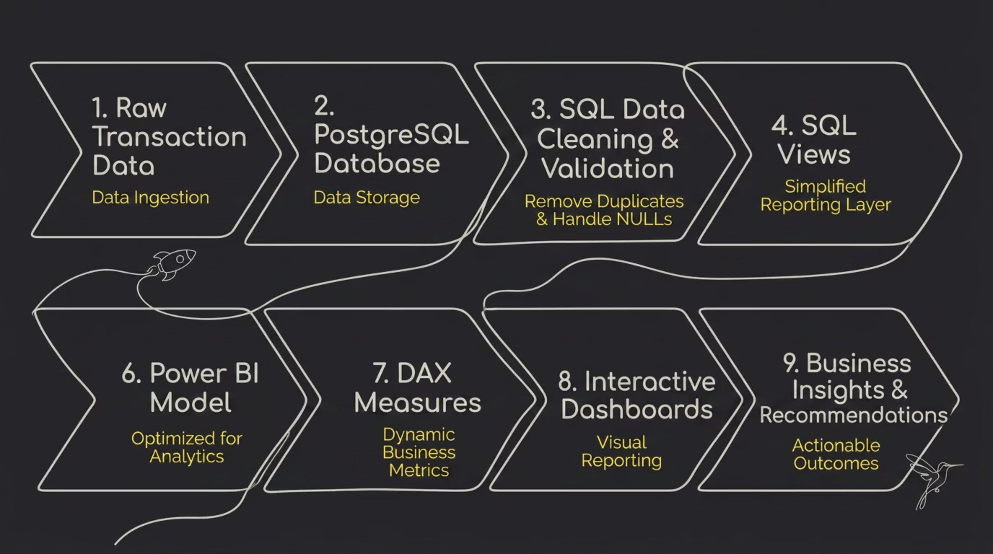
Project Architecture
The complete data flow moves from raw source data through a structured pipeline transaction data through to business insights and recommendations
Source data from GoldVista's branches flows into a PostgreSQL database, where SQL cleaning views standardize and prepare the data. A star schema organizes the cleaned data into fact and dimension tables, which Power BI consumes to build its data model with DAX measures. The result is a set of interactive dashboards that enable business decision-making across the organization.

Slide 8

Data Cleaning & Transformation
Before building the dashboards, the raw transactional data was cleaned and validated using SQL to ensure accuracy and consistency. This section covers the data preparation process, the DAX measures that powered the Power BI dashboards, the challenges encountered, and future enhancement opportunities.
DATA ENGINEERING
POWER BI
SQL

Slide 9
The Data Cleaning Process
Raw transactional data was cleaned and validated using SQL to ensure accuracy and consistency before any analysis was performed. The following steps were applied to prepare the dataset for reporting.
1
Remove Duplicates
Removed duplicate records to prevent duplicate sales calculations.
2
Handle NULL Values
Handled missing (NULL) values to improve data completeness.
3
Standardize Dates
Standardized date formats to enable accurate time-based analysis.
4
Correct Inconsistencies
Corrected inconsistent data to maintain quality across tables.
5
Flag Returns
Flagged return transactions to separate sales from returns.
6
Create SQL Views
Created SQL views to simplify reporting and Power BI integration.
7
Validate Relationships
Validated relationships to ensure referential integrity between tables.

Slide 10
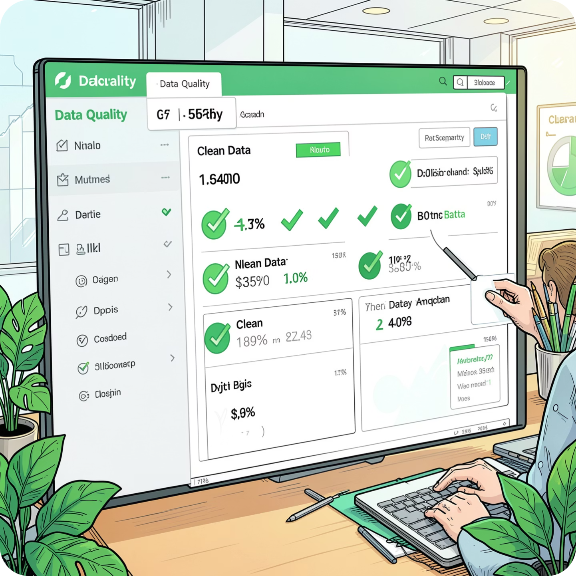
Key Outcomes of Data Cleaning
What Was Achieved
Improved data accuracy and reliability across all tables
Created a clean, validated dataset ready for reporting
Enhanced dashboard performance and consistency
These steps ensured that the dashboards were built on accurate and reliable data, enabling management to analyze business performance interactively using filters and slicers.

Slide 11
SQL Business Analysis
Eight business challenges were solved using advanced SQL techniques — including GROUP BY, JOINs, Window Functions, CASE statements, CTEs, and Aggregate Functions.
Executive Analysis
Branch Analysis
Company-wide KPIs
Compare branch performance
Product Analysis
Customer Analysis
Best-selling products
Customer behavior patterns
Returns Analysis
Buy-back Analysis
Return trends and rates
Old gold activity tracking
Payment Analysis
Salesperson Analysis
Payment method preferences
Employee performance metrics

Slide 12
Key DAX Measures
Power BI dashboards were powered by several DAX measures, including Total Revenue, Average Invoice Value, Return Percentage, Customer Lifetime Value, and Month-over-Month Growth. These dynamic calculations allow management to analyze business performance interactively using filters and slicers across branches, products, customers, and time periods.
Total Revenue
Invoice Count
Total sales excluding returns
Number of sales invoices
Customer Count
Average Invoice Value
Number of unique customers
Average revenue per invoice
Return Count
Return %
Total return transactions
Return rate based on invoice count

Slide 13
Advanced DAX Measures
In addition to core revenue and transaction metrics, advanced DAX measures were created to support deeper customer analysis and financial performance tracking.
Making Revenue
Discount Amount & %
Total making charges collected
Total discounts provided and percentage of discount against revenue
New & Repeat Customers
Customer Lifetime Value (CLV)
Customers with first purchase vs. customers with multiple purchases
Average revenue generated per customer
Purchase Count
Month-over-Month Growth
Number of purchases by each customer
Monthly revenue growth percentage

Slide 14
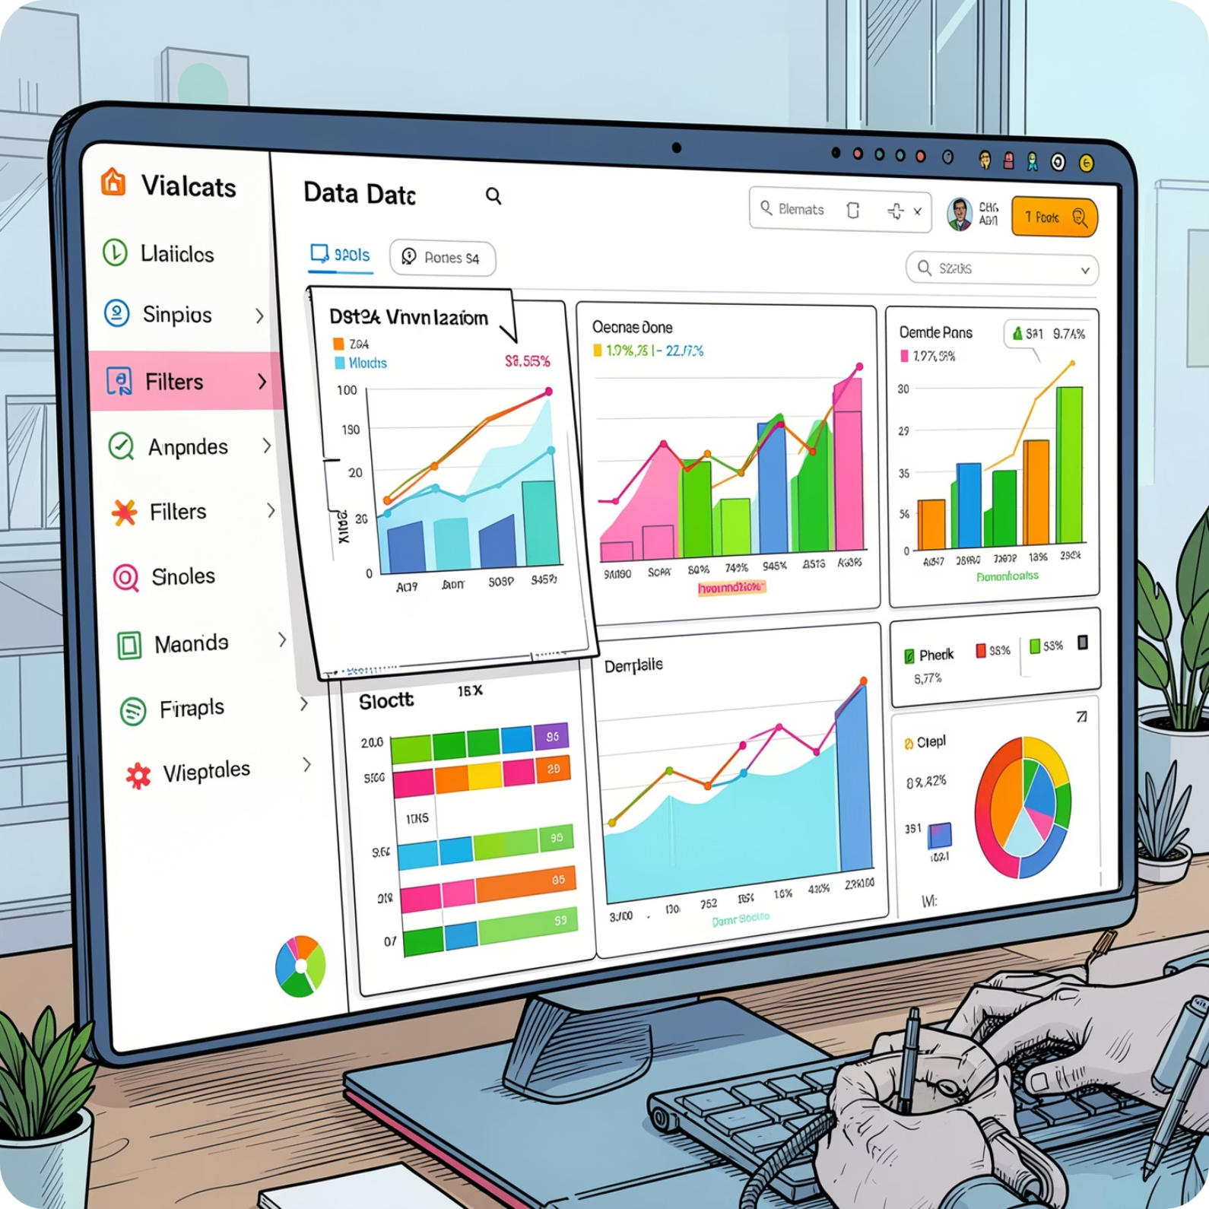

Why DAX?
Dynamic Calculations
DAX measures provide dynamic calculations that automatically update based on filters and slicers, enabling interactive analysis across branches, products, customers, and time periods.
These dynamic calculations allow management to analyze business performance interactively, supporting data-driven decision-making at every level of the organization.
DAX measures power all 6 interactive dashboards, updating automatically as users apply filters and slicers.

Slide 15
Data Model — Star Schema
Schema Structure
Why Star Schema?
The star schema centers on a Fact Sales table connected to dimension tables: Dim Branch, Dim Product, Dim Customer, and Dim Date. All relationships use one-to-many joins from dimension to fact tables.
A star schema improves reporting performance by simplifying queries and reducing join complexity. With denormalized dimension tables and a single fact table at the center, Power BI can aggregate large volumes of transactional data efficiently — enabling fast, responsive dashboards for executive and operational reporting.
Fact Tables
Dimension Tables
Store transactional records — sales, returns, and buy-backs
Branch, Product, Customer, and Date attributes
One-to-Many Joins
Dimensions connect to facts via foreign keys

Slide 16
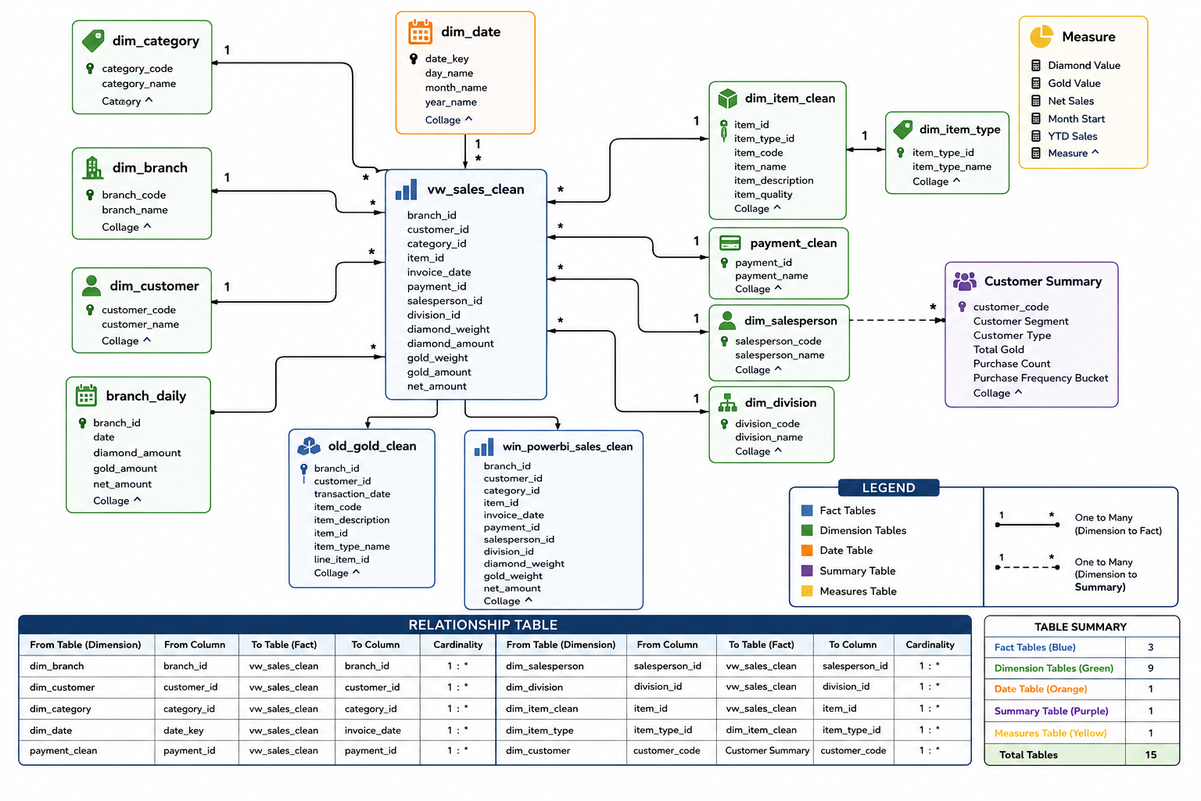
Data Model — Star Schema

Slide 17

Business Intelligence Dashboard Suite
An end-to-end BI solution built with PostgreSQL and Power BI — transforming raw transactional data into strategic insights across sales, customers, branches, products, payments, and returns.
6 INTERACTIVE DASHBOARDS
8 BUSINESS CHALLENGES SOLVED

Slide 18
Executive Summary Dashboard
Key performance indicators and strategic insights across revenue, products, branches, and customer metrics — with clear recommendations
for growth.
SAR 348.3M
2.58M g
Total Revenue
Total Weight Sold
Overall business revenue for the period
2,577,238 grams of gold sold
10,013
SAR 5,675
Active Customers
Avg. Invoice Value
Customers with active transactions
Across 61K invoices
1.7%
SAR 29.63M
Return Rate
Making Revenue
Low return rate, strong quality
Revenue from craftsmanship and making charges
Key Insights
Business Recommendations
22K products generated SAR 206.41M — the largest single revenue contribution
Gold division generated approximately SAR 321.95M, representing the dominant share of total revenue
Branch 16 was the highest revenue contributor at approximately SAR 37M
Revenue growth versus last year was 4.19%
Monthly revenue trend shows strong performance in early 2026
Increase inventory allocation for 22K products to capture sustained demand
Replicate sales strategies from top-performing branches across the network

Slide 19

Branch Performance Dashboard
Branch-level analysis reveals significant performance variation across the network. Branch 16 leads revenue generation, while top salespeople drive disproportionate value — creating clear benchmarks for operational improvement.
SAR 348.3M
2,577,238 g
Selected Branch Revenue
Total Weight Sold
#1 / 20
SAR 5,675.43
Branch Rank
Average Transaction Value
Branch & Payment Insights
Top Salesperson — ID 103
Branch 16 generated approximately SAR 37M in revenue — the highest among all 20 branches
Branch 18 demonstrated strong average transaction values, indicating premium customer engagement
Cash accounts for approximately 59.5% of all payment methods, underscoring the continued dominance of physical currency
Revenue: SAR 27.3M
Weight Sold: 271,931 g
Transactions: 4,483
Salesperson 103 generated the highest individual revenue across all branches — a clear benchmark for peer performance.
Recommendation: Benchmark Branch 16 operations and replicate best practices. Deploy targeted training programs for lower-performing branches to close the performance gap.

Slide 20
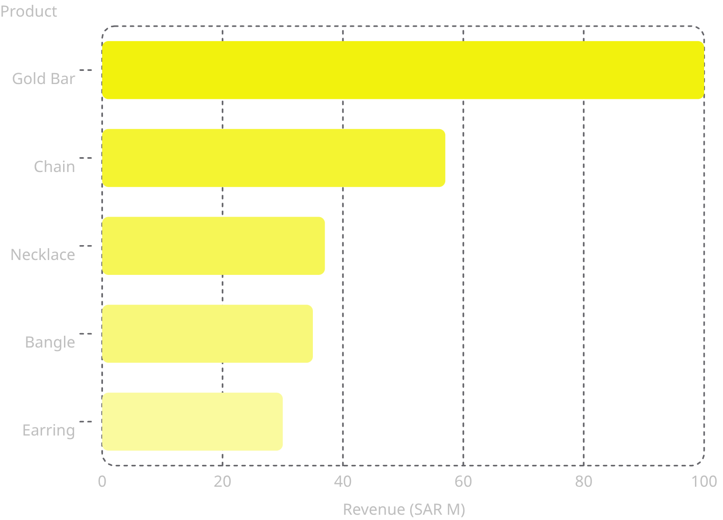

Sales & Product Dashboard
Product-level analysis reveals a concentrated revenue structure. Gold Bars dominate sales, while a small number of high-value SKUs generate the majority of business revenue — presenting clear inventory optimization opportunities.
Key Product Insights
Gold Bars generate the highest revenue at SAR 100M
Chains contribute approximately 18.4% of total revenue at SAR 57M
Top five products account for a substantial share of total revenue
Average making rate of 11.50 drives SAR 29.63M in making revenue
Overall discount rate stands at 11.11%
Recommendation: Increase stock levels for Gold Bars and Chains. Review and rationalize low-performing product lines to improve inventory efficiency.

Slide 21
Customer Intelligence Dashboard
The customer base is overwhelmingly composed of first-time buyers, revealing a significant untapped retention opportunity. With over 41K one-time customers, even modest improvements in repeat purchase rates could materially impact long-term revenue.
45.62K
41.40K
4.22K
Total Customers
New Customers
Returning Customers
Across all branches
First-time buyers this period
Repeat purchasers
9.25%
SAR 7.63K
Repeat Purchase Rate
Avg. Customer LTV
Significant room for improvement
Current average lifetime value
Key Insight: New Customer Dependency
Strategic Recommendations
One-time customers account for approximately 41.4K of the total base. Returning customers represent only 4.22K — just 9.25% of the customer base. Revenue is heavily dependent on continuous new customer acquisition, creating vulnerability if acquisition costs rise.
Launch structured loyalty and rewards programs to incentivize repeat visits
Implement targeted customer retention campaigns with personalized communication
Create exclusive offers and early-access privileges for repeat buyers to increase lifetime value

Slide 22

Returns & Buy-Back Dashboard
The buy-back program is a significant secondary revenue stream, contributing SAR 37.8M through old gold acquisition. Return rates remain low, indicating strong product quality and customer satisfaction across the network.
Buy-Back KPIs
Key Insights
Old Gold Volume: 1,437.53 g
Old Gold Value: SAR 37.8M
Return Rate (Count): 1.73%
Return Rate (Value): 10.84%
The buy-back program contributes SAR 37.8M — a meaningful secondary revenue channel
Return rates remain low at 1.73% by count, reflecting strong product quality
Return rate by value (10.84%) suggests higher-value items may have slightly elevated return propensity
Branch-level variation in buy-back performance indicates opportunity to standardize best practices
Branch 02 generated approximately SAR 7.0M in buy-back value, while Branch 05 contributed approximately SAR 6.8M — together accounting for a substantial share of total old gold acquisitions.
Recommendation: Expand old gold promotional campaigns to grow the buy-back pipeline. Investigate branches with higher return percentages to identify root causes and implement corrective measures.

Slide 23
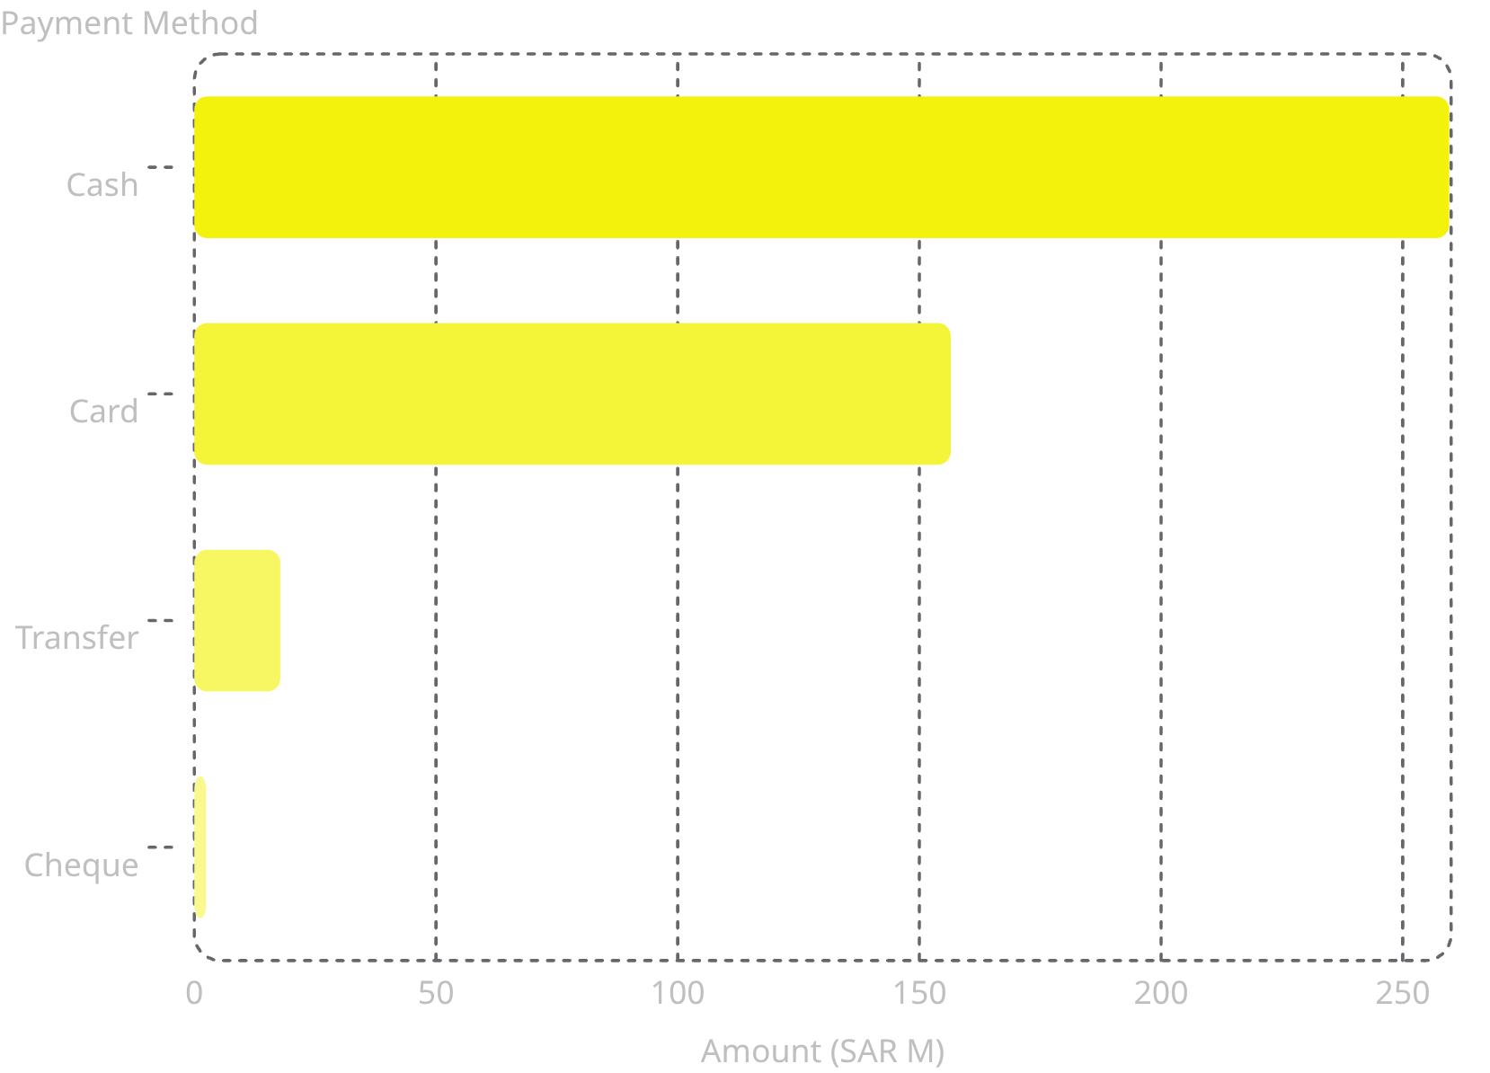

Payment & Salesperson Dashboard
Cash remains the dominant payment method, though digital channels represent a growing opportunity. Top salespeople demonstrate exceptional productivity, providing a clear performance benchmark for incentive and training programs.
Payment Insights
Total Cash Collection: SAR 211.23M
Total Card Collection: SAR 92.73M
Cash accounts for the majority of transactions, but card and digital payments represent significant untapped potential
Top Salesperson — ID 105
Revenue: SAR 23.8M
Weight Sold: 271,331 g
Transactions: 4,483
Average Transaction Value: SAR 5,350.59
Average transactions per salesperson stand at 390.83, with top performers significantly exceeding this benchmark.
Recommendation: Encourage digital payment adoption through customer incentives. Implement KPI-based incentive plans tied to revenue, transaction volume, and average transaction value.

Slide 24
Key Business Findings
A consolidated view of the most critical findings across all business dimensions — revenue, customers, products, branches, returns, buy-back, and payments — with clear strategic implications for the next planning cycle.
Revenue
Customers
Total revenue of SAR 348.3M, with 4.19% year-on-year growth. Gold division contributed approximately SAR 321.95M.
45.62K total customers with only a 9.25% repeat purchase rate — significant retention opportunity remains untapped.
Products
Branches
Gold Bars generate the highest revenue. The 22K product category dominates sales, contributing SAR 206.41M.
Branch 16 leads revenue generation at approximately SAR 37M. Benchmark operations for network-wide replication.
Returns
Buy-Back & Payments
Return rate of only 1.73% by count reflects strong product quality and high customer satisfaction across branches.
Old gold contributes SAR 37.8M. Cash remains the dominant payment mode; digital adoption is a strategic priority.

Slide 25
Business Recommendations
Based on the dashboard insights, the following strategic actions are recommended to drive growth, improve
retention, and optimize operations.
Customer Loyalty
Stock Optimisation
Buy-Back Campaigns
Increase stock for high-performing products, particularly 22K jewellery and Gold Bars & Chains
Introduce customer loyalty programmes to convert one-time buyers into repeat customers
Expand old gold buy-back campaigns to drive additional business volume
Digital Payments
Branch Benchmarking
Discount & Incentives
Encourage digital payment adoption to reduce cash dependency across branches
Benchmark top-performing branches to replicate best practices across the network
Optimise discount policies and implement KPI-based salesperson incentives
Predictive Analytics
Use predictive analytics for demand forecasting to improve inventory and sales planning

Slide 26

Challenges Faced
During the project, the main challenges involved preparing high-quality data and designing an efficient analytical model.
Data Preparation
Cleaning and validating large transactional datasets, and handling duplicate and inconsistent records.
Data Modeling
Designing an optimized Star Schema data model and managing relationships between fact and dimension tables.
Reporting Design
Creating efficient DAX measures for dynamic reporting and building dashboards that balance detail with usability.

Slide 27
GoldVista Jewellers — Retail Analytics Executive Summary
A Business Intelligence solution built with PostgreSQL, SQL, Power BI, and DAX transforming retail transaction data into a centralized reporting platform for sales, customer behavior, branch productivity, and product profitability.
Key Business Metrics
SAR 348M
61K
10,013
Total Revenue
Invoice Count
Active Customers
Across all branches
Total transactions
Of 45.62K total
SAR 5,675
2.58M g
SAR 29.6M
Avg Invoice Value
Total Weight Sold
Making Revenue
Per transaction
In grams
Craftsmanship charges
1.73%
SAR 37.8M
9.25%
Return Rate
Old Gold Value
Repeat Purchase
Low, reflecting quality
Buy-back program
Retention opportunity

Slide 28
Major Business Insights
Customer & Operations
Product & Revenue
Strong acquisition, but only 9.25% repeat rate — major retention opportunity
Old Gold Buy-Back generated SAR 37.8M as a key revenue driver
1.73% return rate reflects strong product quality and satisfaction
22K Jewellery dominates revenue share
Gold Bars and Chains are top-performing products
Branch 16 leads branch-level revenue
Cash remains the dominant payment method
Strategic Recommendations
Launch Customer Loyalty Programs
Address the 9.25% repeat purchase gap with targeted retention initiatives.
Optimize Inventory Allocation
Increase stock for 22K Jewellery, Gold Bars, and Chains.
Benchmark Top-Performing Branches
Replicate Branch 16's success across the network.
Promote Digital Payment Adoption
Reduce cash dependency and improve transaction traceability.
Expand Old Gold Buy-Back Campaigns
Scale the SAR 37.8M buy-back program to drive incremental revenue.
Implement Predictive Analytics
Deploy forecasting models for demand planning and inventory optimization.
Project Outcome: Transformed raw retail data into a comprehensive BI platform enabling faster, data-driven decisions across sales, customers, products, and operations.

Slide 29
Future Enhancements
In future, this solution can be enhanced with predictive analytics, customer churn models, demand forecasting, and real-time reporting to provide even greater business value.
Predictive Analytics
Demand Forecasting
Implement machine learning for sales forecasting and predict customer churn and buying behavior.
Develop demand forecasting for inventory optimization.
Real-Time Reporting
AI Recommendations
Enable real-time dashboard refresh for up-to-the-minute business insights.
Add AI-driven product recommendations and create mobile-optimized executive dashboards.

Slide 30
Thank You

